Slide 1
Scraping Thumbtack for Insights
Swarup Malli
NYC DSA Webscraping project

Slide 2
About Thumbtack
Thumbtack is an online service that matches customers with local professionals. Currently, Thumbtack lists 1,100 types of services in categories such as home, wellness, events, and lessons.
Thumbtack’s major competitors are HomeAdvisor and Angies List .

Slide 3
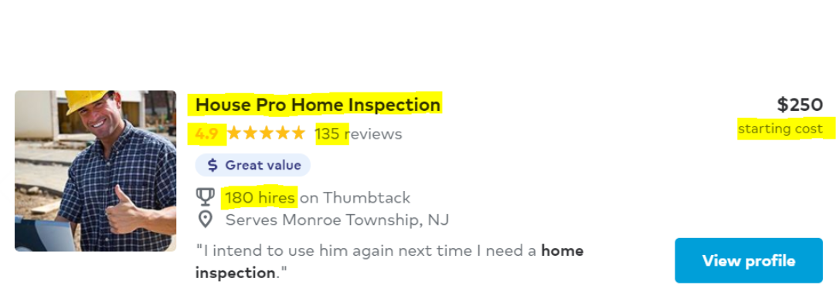
Project Description
Extracted the above highlighted data points from over 1028 Home inspectors from all over the United states

Slide 4
Goal of the project is to find …
Top 10 businesses by number of hires and they ratings
The range of ratings of businesses that have highest number of hires
Determine the Average ,Max and minimum starting price of a service providers
Find tips on how to pick a good home inspector on Thumtack
Compare Hires vs Rating
Reason why some have 5-star ratings

Slide 5
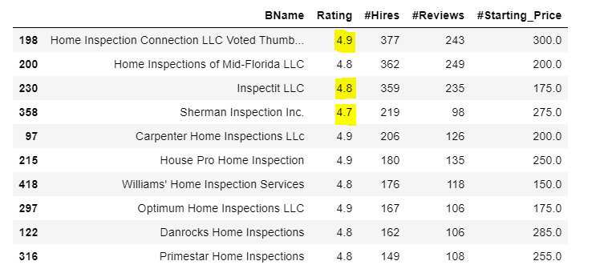
Top 10 Businesses by #Hires and they corresponding Ratings

Slide 6
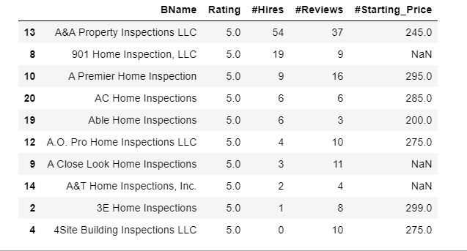
Businesses with 5-star ratings

Slide 7
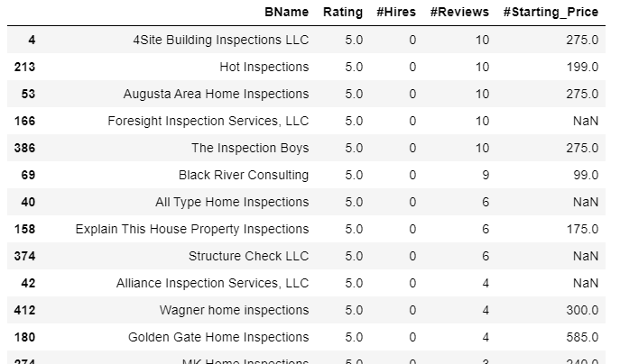
Business with 5-star rating and zero hires

Slide 8
Starting Price
The average starting price across the country is 260 USD.
Minimum starting price 96 USD
Maximum starting price is 585 USD
Businesses that listed they starting price made up 84% of hiring share vs 16% of those who didn’t in the dataset.
Listing pricing on the website helps to improve the business

Slide 9
Conclusion
Relation between 5-star rating and number of Hires
5-star rating doesn’t necessarily translate to greater number of hires.
Business with 5 star rating tend to be relatively new to the market.
For Customers before hiring a home inspector:
Look for number of hires along the star rating ,instead of just relying on star rating and number of reviews.
For Businesses trying to advertise on Thumtack :
Advertising the starting price on the website can improve the business drastically.
Businesses that provided services in multiple areas got more business compared to those who didn’t

Slide 10
Thank You

